Slide 1
Project Elixir @ Creating Futures
Technical Details

Slide 2
Technical Requirements
Application should be able work in offline mode
Application should be able to support different types of questions like match the following, fill in the blanks
Application should adhere to data privacy by incorporating basic levels of security

Slide 3
Technologies used
Python (version 3.7.4 preferably)
Server and framework : Django (with WSGI)
While deploying on the domain, we will use Apache
Database : SQLite
UI/UX : Bootstrap / Html, CSS, Javascript, Phaser.io

Slide 4
Technical Approach
Application will be hosted on Azure
Admin Functionality
Admin UI
Session based questions
Connect to download session details (Questions)
Django
SQLite
Backend
Mobile App
Re-sync post the session to upload results
MySql

Slide 5
Documentation Repository
We will use Google Drive as our Document Repository
https://drive.google.com/drive/folders/1n7zqdSC8ZY0b5BAXh-9oSB7sE5J31PyN
or
https://drive.google.com/open?id=1n7zqdSC8ZY0b5BAXh-9oSB7sE5J31PyN
Document Type | File Name
UI Prototype | elixir_admin UI.pdf
Database Design | Database Design : DB Design CF Skill Development App.xlsx.xlsx

Slide 6
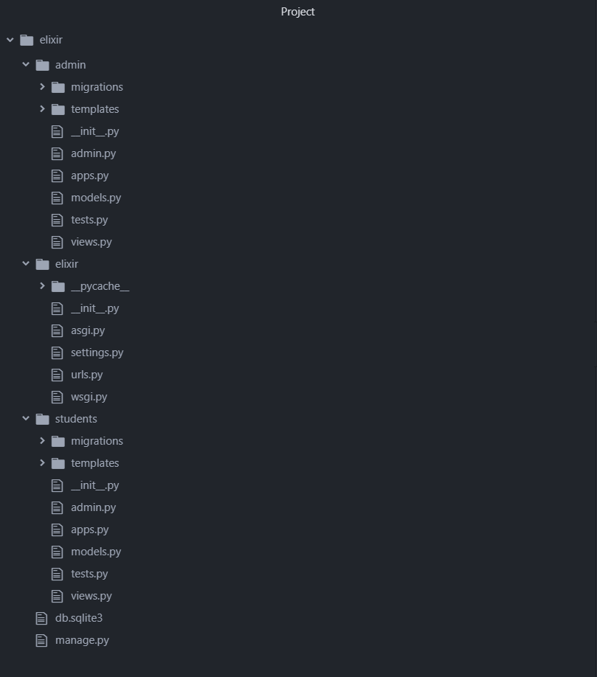
Github Repository Structure (Example)
https://github.com/creatingfutures/seApp

Slide 7
Release & Branching strategy- Code Base
Developer 2
Developer 1
Development Branch
Production Branch
Step2
Tested code that is planned for an upcoming release to be checked in Development branch
Integration testing of all functionality planned for release will be done in this branch - by QA/ testing volunteers
Step3
Code merge will be strictly done by release manager
Copy of previous version to be backed up before releasing new version to support roll back
Branch to be tagged with appropriate versions
Developer 3
Step1
Each developer can have their own specific branch (if needed)
Sharing of code between developers can be done using specific branch

Slide 8
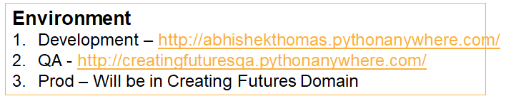
Github Repository Structure
https://github.com/creatingfutures/ElixirWebApp
•Creatingfutures
•ElixirWebApp
•User_admin
•User_student
•DB
•Creating_futures
•Static
•Scripts
•Media
•ElixirMobileApp
•Create release - Current release – 0.8 - DONE
•Then once the folders are created, we create release 1.0 - WIP
•The new DB and new changes will be in release 1.1

Slide 9
Release & Branching strategy- Database
Step1:
DBA to check in database structure changes to Development branch
Migration script has to be created to migrate data from old - new structures before check in
Developer 2
DBA
Developer 1
Development Branch
Production Branch
Step3
Only code to be checked in, any changes needed in DB should be communicated to the DBA
Step 4
Migration script to be created to migrate data from old structure to new structure using the same migration script in QA
Deployed of new db file
Migrate the data and validate the sanity of existing data
Updated code to be merged after database is deployed
Developer 3
Step2.
Teams to taken the new structure to their specific branch
Update the functionality accordingly

Slide 10
Responsibilities
DBA
Design DB structure based on the functionality
Create the db structure and upload to development branch
Create migration script to transfer data from old db to new db in QA and Prod
Release Manager
Merge code base from Development Branch to QA and Production Branch
Lock the db files changes in Production to avoid accidental overwriting
Create script to backup production data files periodically.

Slide 11
Responsibilities
Developers
Create individual branch if needed
Ensure only tested code is checked in to development branch
Do not commit code to QA or Production with prior approvals
Do not make changes in DB structure with our approval from DBA
Update fellow developers when code is committed to development branch

Slide 12
Deployment Strategy
Production : Creating futures domain
New Functionality
Bug fix
Planned Minor changes
QA: Pythonanywhere
Post UAT certification
Production : Laptops/ mobile
Steps: QA Deployment (TODO)
step1
step2
Steps: Production Deployment (TODO)
step1
step2

Slide 13
Software Setup for development
Python >3.6 [3.7.6 preferred]
django [ Install command in cmd : pip install django ]
crispy forms [ Install commmand in cmd : pip install django-crispy forms ]
pillow [ Install command in cmd : pip install pillow ]
django Rest Framework (For later use) [ Install command in cmd : pip install djangorestframework ]
Download DB browser for sqlite3 [ To view the databases ]

Slide 14
Application setup
clone/download github repository into a separate folder
navigate into this folder using command prompt
Commands :
python manage.py makemigrations
python manage.py migrate
python manage.py runserver
open http://127.0.0.1:8000/ on Mozilla / Chrome
Admin login :
username : creatingfutures
password : creatingfutures2@
(Additional Step) if you want to view database without downloading software go to http://127.0.0.1:8000/admin

